Slide 1

Ujian tengah semester
Praktikum Algoritma dan Struktur Data 2021

Slide 2
soal
Buatlah sebuah sistem informasi perbankan yang terdiri 2 kelas diagram yaitu Rekening dan Transaksi. Pada sistem informasi tersebut dapat menginputkan data, menampilkan data, mengurutkan data kriteria tertentu, dan mencari data. Untuk lebih jelasnya perhatikan class diagram dan output dari program tersebut, silakan menggunakan data yang telah disertakan. Catatan: Untuk tampilan dan class diagram boleh dimodifikasi atau ditambahkan tetapi tidak boleh dikurangi.

Slide 3
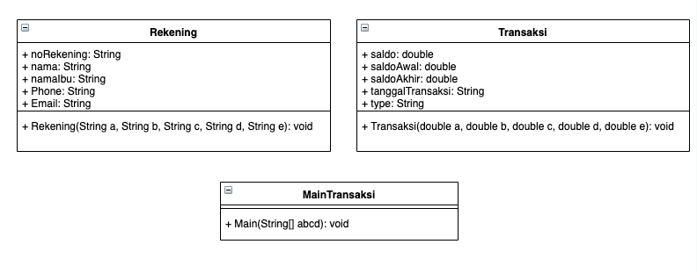
Class diagram

Slide 4
output

Slide 5
Data dummy 1
No Rekening,NamaBelakang,NamaDepan,Phone,Email, Saldo,Saldo Awal,Saldo Akhir,Tanggal Transaksi
160309273084,”bin Abdul Salam”,”Aruffin”,14582643263,”ligula.Nullam@tacitisociosqu.edu”,898214,494048,3587,”2021-03-09 07:54:42”
169712042416,”Al Hafeezy”,”Mohammad”,16834168323,”ut.pellentesque@luctusutpellentesque.com”,770592,334245,444267,”2020-08-11 13:36:56”
161007278862,”bin Azzarudin”,”Ehsan”,6505379,”Proin.eget@velitegestaslacinia.ca”,685302,451002,376442,”2020-05-23 07:34:53”
161807297229,”Fadhullah”,”Jeanne Roselia”,8638209,”Pellentesque.ut.ipsum@neque.ca”, 297103,396116,779589,”2021-07-03 01:09:49”
169503136823,”Nohara”,”Shinnosuke”,5926919,”tellus.justo.sit@commodoauctor.net”, 66190,259150,619774,”2021-09-09 03:57:30”
168507083528,”Nohara”,”Hiroshi”,11153397678,”dictum@nec.edu”, 234301,278309,547922,”2021-08-24 13:18:39”
160802059329,”Nohara”,”Misae”,18917032664,”vel@ullamcorpermagna.co.uk”, 243306,869468,50283,”2021-03-12 03:40:16”
160806282695,”Nohara”,”Himawari”,19786325110,”Aliquam.gravida@vestibulumMauris.net”, 371045,991242,602034,”2021-08-06 11:48:59”
161309092979,”Nobi”,”Nobita”,8171766,”interdum.Curabitur.dictum@rutrumurna.edu”, 395170,97058,472273,”2021-05-02 10:53:31”
168902128688,”Takeshi”,”Goda”,16754004501,”et.ultrices@a.co.uk”, 862731,561908,109431,”2021-07-31 08:11:00”
161410089963,”Kudo”,”Shinichi”,5279085,”ut@aultriciesadipiscing.ca”, 556798,31387,725426,”2021-03-27 06:18:20”
165112227763,”Ai”,”Haibara”,15644194285,”Proin.velit@Duisac.net”, 873982,896213,846142,”2021-07-18 04:06:30”
167206230943,”Mouri”,”Ran”,9776690,”ac@nibhAliquamornare.com”,774247,739406,775848,”2020-10-24 01:39:00”
167711267372,”Mouri”,”Kogoro”,3535137,”cubilia.Curae.Phasellus@Duis.com”,66987,823014,868772,”2020-12-21 05:57:59”

Slide 6
Pengguna data dummy 1
IFTITAH HIDAYATI
IZZATUN NAULY
MAULANA BINTANG IRFANSYAH
MELIUSA NORA HARIYANTI
MOCHAMAD ADITYA BAGUS
MOCHAMMAD HAIRULLAH
PRIHATINI PUJI RAHAYU
PUTRI MAULIDA SITO RESMI
RIO ADRIANSYAH
SAFIRA ISTIFARINI
SATRIYA RIFKI PANGESTU
SISWI DIAH PRIADHITA DEWI
DEWI LAYLATURROHMAH
YOGA RAHMAHADI
YOBY RYAIAN PRATAMA

Slide 7
Data dummy 2
No Rekening,NamaBelakang,NamaDepan,Phone,Email, Saldo,Saldo Awal,Saldo Akhir,Tanggal Transaksi
161006170573,”bin Abdul Salam”,”Ariffin”,13578430547,”nec@lectusjusto.org”, 205420,200162,775880,”2021-06-25 10:23:00”
162404012243,”bin Mail”,”Ismail”,5717062,”convallis@Vestibulumanteipsum.org”,838632,350929,328316,”2021-09-18 23:00:04”
162705250112,”Singh”,”Jarjit”,6230234,”porttitor.tellus.non@Curabitur.ca”,230659,204434,690503,”2022-02-02 19:10:34”
164603294259,”bin Khamis”,”Isnin”,8977608,”pede.Suspendisse.dui@a.ca”, 816129,851403,597842,”2021-07-18 19:41:20”
163204213437,”Xiao”,”Mei Mei”,7924447,”non@mus.com”, 989609,333823,802752,”2022-02-01 01:13:11”
161807297229,”Fadhullah”,”Jeanne Roselia”,8638209,”Pellentesque.ut.ipsum@neque.ca”, 297103,396116,779589,”2021-07-03 01:09:49”
169503136823,”Nohara”,”Shinnosuke”,5926919,”tellus.justo.sit@commodoauctor.net”, 66190,259150,619774,”2021-09-09 03:57:30”
168507083528,”Nohara”,”Hiroshi”,11153397678,”dictum@nec.edu”, 234301,278309,547922,”2021-08-24 13:18:39”
160802059329,”Nohara”,”Misae”,18917032664,”vel@ullamcorpermagna.co.uk”, 243306,869468,50283,”2021-03-12 03:40:16”
160806282695,”Nohara”,”Himawari”,19786325110,”Aliquam.gravida@vestibulumMauris.net”, 371045,991242,602034,”2021-08-06 11:48:59”
161309092979,”Nobi”,”Nobita”,8171766,”interdum.Curabitur.dictum@rutrumurna.edu”, 395170,97058,472273,”2021-05-02 10:53:31”
168902128688,”Takeshi”,”Goda”,16754004501,”et.ultrices@a.co.uk”, 862731,561908,109431,”2021-07-31 08:11:00”
161410089963,”Kudo”,”Shinichi”,5279085,”ut@aultriciesadipiscing.ca”, 556798,31387,725426,”2021-03-27 06:18:20”
167711267372,”Mouri”,”Kogoro”,3535137,”cubilia.Curae.Phasellus@Duis.com”,66987,823014,868772,”2020-12-21 05:57:59”

Slide 8
Pengguna data dummy 2
ADITYA KUNCARA BAKTI
AIDA MILLATI MARDIANA
AULIA GUSTI RAHMAN
CINTYA APRILA FANDINI
DANDY KURNIA FIRMANSYAH
DAWAM ILHAMI ASSIDIQI
DEKI FIRMANSYAH
DHERISMA HANINDITA UTAMI
DILTA FEBIANA
FAI NUR JANAH
FAIZA ADHIRA KURNIAWATI
FAIZA KURNIA PUTRI
FERDIANSYAH WARDANA PUTRA
GUSTANIA NIRMALA MEISI

